Slide 1
Introduction to Systems Design
Comp2120
Abid Rana
References: Systems Analysis and Design with UML Dennis et al (2009)
Object Oriented Analysis and Design with Unified Process Satzinger et al (2005)

Slide 2
Systems Analysis
determines the business needs
[Focus on Functional Requirements]
Systems Design
determines how to build the system
[Focus on Functional/Non Functional Requirements]
System performance
Maintainability, Scalability, Affordance, Effectiveness
System environment issues
Distributed vs. centralized processing
User interface
Database
Analysis and design phases are highly interrelated and iterative in nature

Slide 3
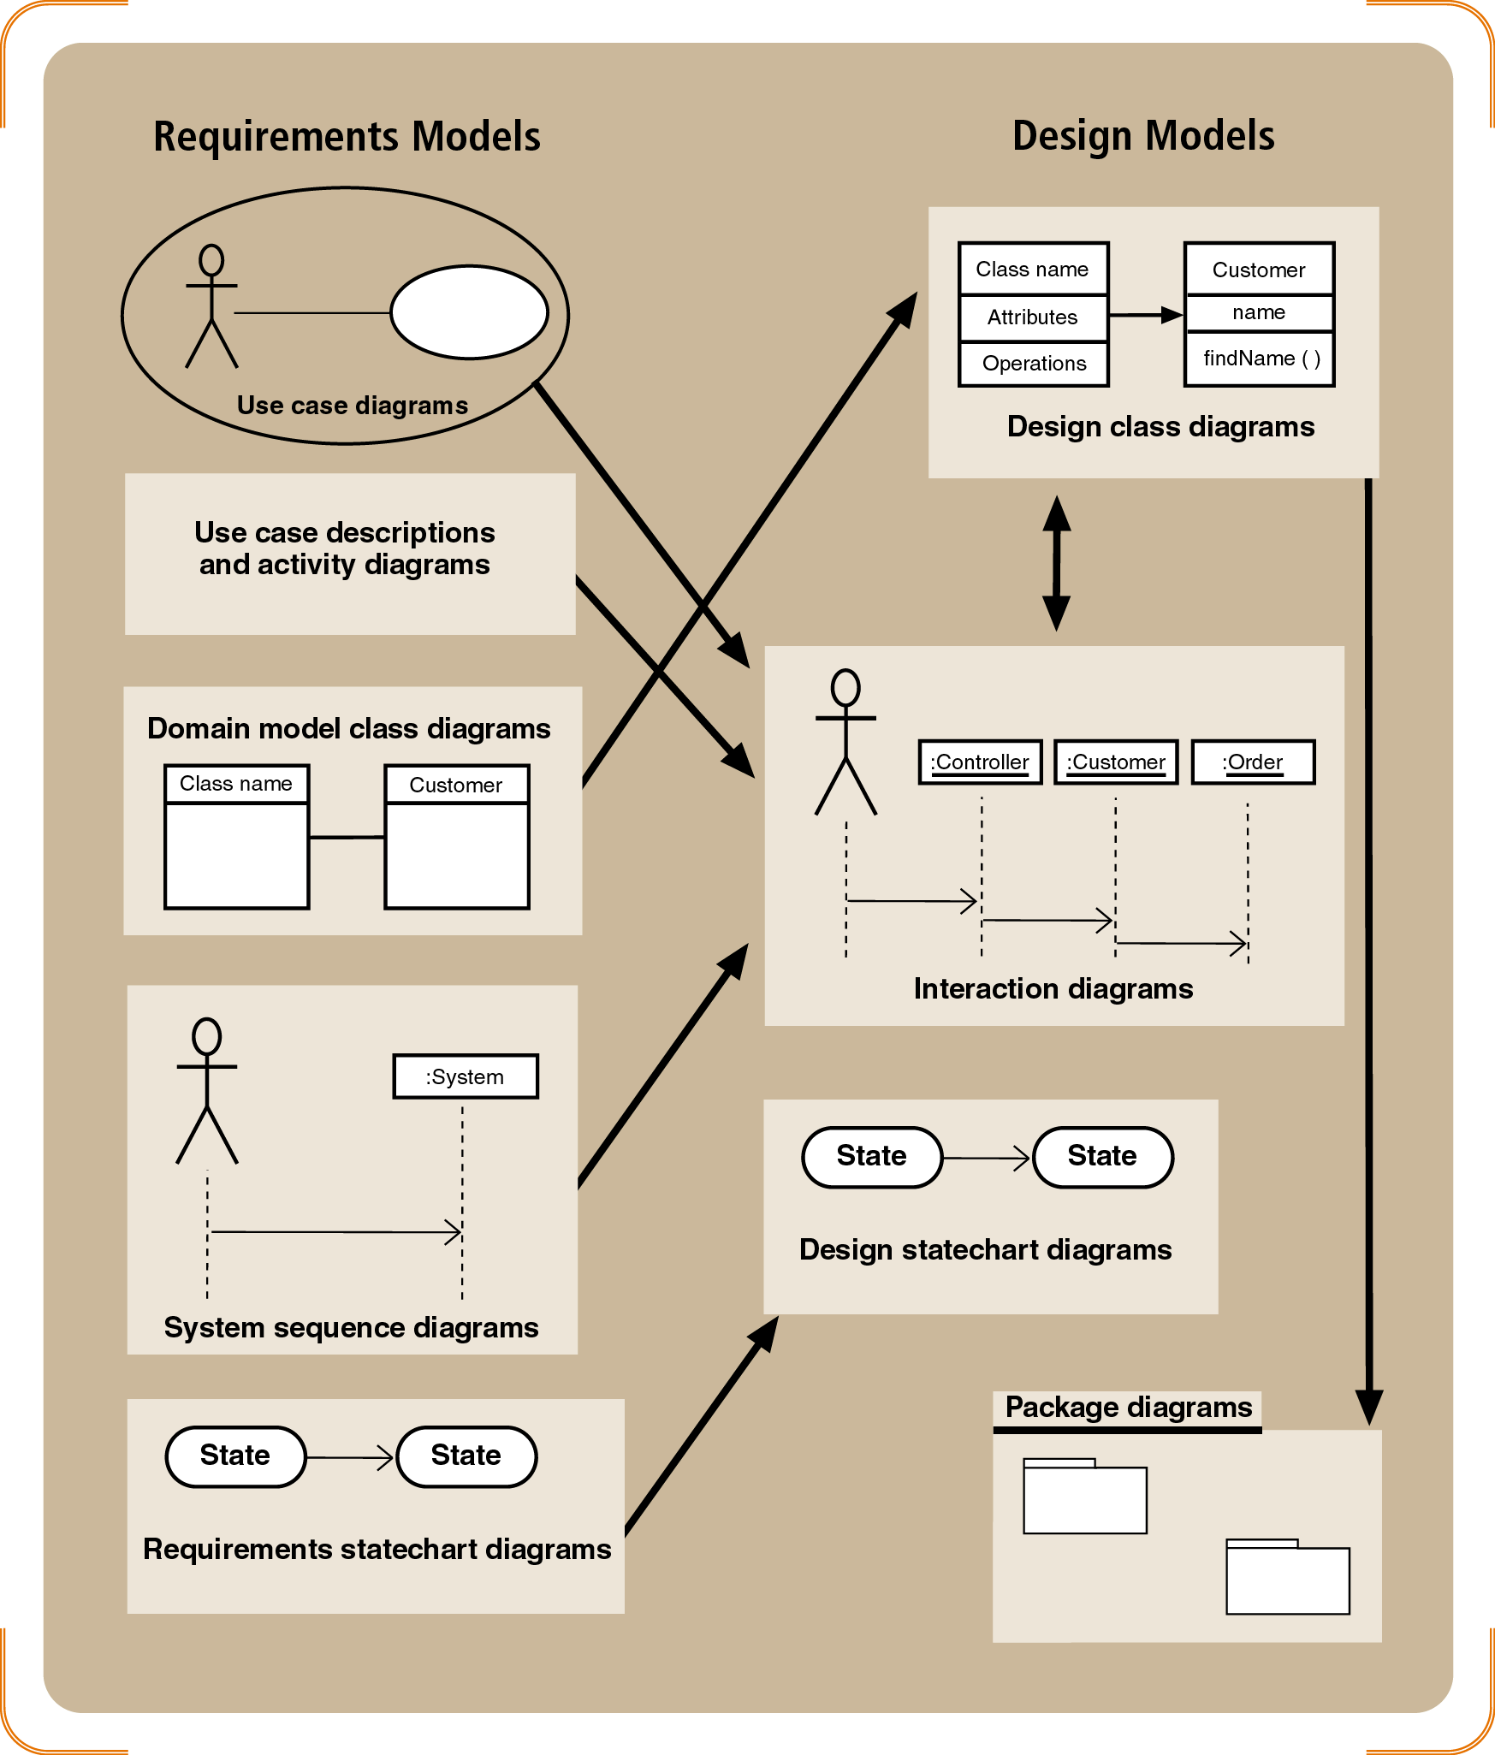
Analysis vs Design Modeling

Slide 4
The Design Process
Verify and validate (V&V) the analysis models
Balancing Functional & Structural Models
Balancing Functional & Behavioral Models
Balancing Structural & Behavioral Models
Evolve the analysis models into design models
factoring, partitioning & collaboration, and layering
Create packages and utilize package diagrams
Generic construct that groups models together and is used to reduce complexity of models. A package diagram shows packages [Model granularity]
Decide upon a design strategy
Custom Development, Packaged Software, Outsourcing

Slide 5
1- Factoring
Creating modules that account for similarities and differences between units of interest
New classes formed through a:
Generalization (a-kind-of) relationship, or a
Aggregation (has-parts) relationship
Abstraction—create a higher level class (e.g., create an Employee class from a set of job positions)
Refinement—create a detailed class (e.g., create a secretary or bookkeeper from the Employee class)

Slide 6
2-Partitioning and Collaboration
Partition: create a sub-system of closely collaborating classes
Base partitions on patterns of activity (e.g., collaborations found in a communication diagram)
Greater coupling among classes may identify partitions (e.g., more messages passes between objects suggests that they belong in the same partition)
Identifying partitions and collaborations
determines which classes should be grouped together

Slide 7
3- Layering (Divide and Rule!)
System environment information must now be added as new layers
Use layers to represent and separate elements of the software architecture
Easier to understand a complex system
Example:
Model-view-controller (MVC) architecture {SmallTalk}
Separates application logic from user interface
Proposed layers:
Foundation (e.g., container classes)
Problem domain (e.g., encapsulation, inheritance, polymorphism)
Data management (e.g., data storage and retrieval)
User interface (e.g., data input forms)
Physical architecture (e.g., specific computers and networks)

Slide 8
Evolution of Analysis Models into Design Models The Object-Oriented Approach [Satzinger et al (2005)]
Create a first-cut model of the design class diagrams
Realize each use case with a sequence diagram
Update the design class diagrams
Method names, attributes, and navigation visibility
Partition the design class diagrams into related functions using package diagrams

Slide 9
Design Class Diagrams
Design class diagrams are extensions of domain class model diagrams
Elaborate on attribute details
Define parameters and return values of methods
Define the internal logic of methods
A first-cut design class diagram is based on the domain model and engineering design principles

Slide 10
Engineering/O-O Design Principles
Encapsulation
Each object is a self-contained unit containing both data and program logic
Object reuse
Standard objects can be used over and over again within a system
Information hiding
Data associated with an object is not visible
Methods provide access to data

Slide 11
Navigation visibility
Describes which objects can interact with each other
Coupling
Measures how closely classes are linked
Cohesion
Measures the consistency of functions in a class
Separation of responsibilities
Divides a class into several highly cohesive classes

Slide 12
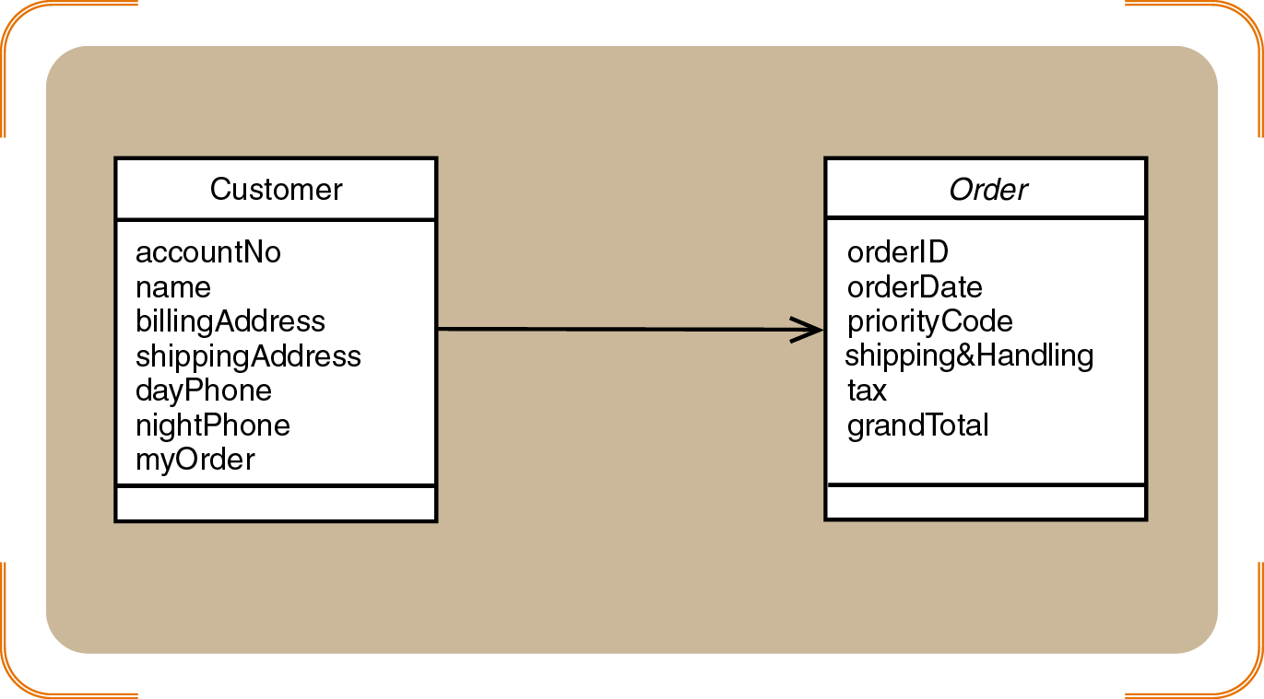
Navigation visibility between Customer and Order - coupling

Slide 13
Developing the First-Cut Design Class Diagram
Elaborate the attributes with type and initial value information
Most attributes should be private
Add navigation visibility arrows
Based on which classes need access to which other classes
Can be bidirectional
Will need to be updated as design progresses

Slide 14
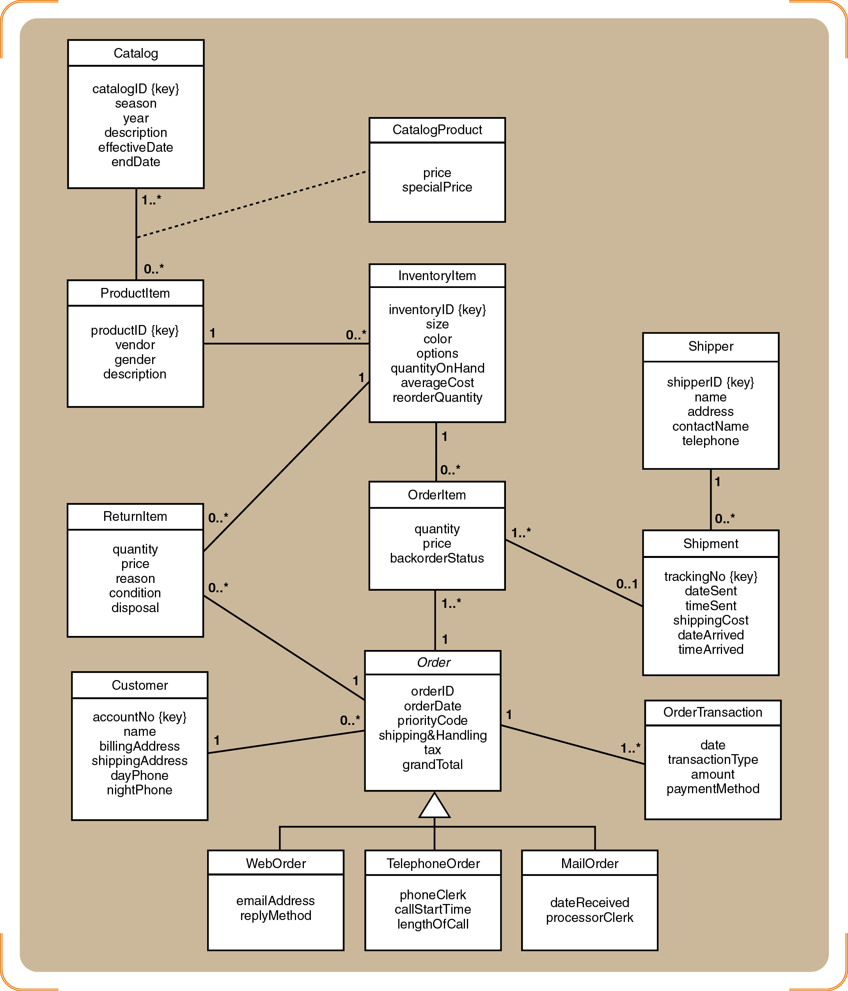
Domain Model Class Diagram

Slide 15
Guidelines for developing Navigation Visibility
Navigation Visibility: is the ability to reference the methods of another object
One-to-many with superior to subordinate. The visibility goes from the superior to the subordinate (order to orderItem)…also could be multilevel hierarchy Catalog—ProductItem to InventoryItem.
Mandatory relationships for existence in which one class owes its existence to another. Visibility goes from independent to dependent (Customer to Order)
An Object needs information from another object. Visibility goes to object that has the information
Navigational arrows may be bidirectional as well.

Slide 16
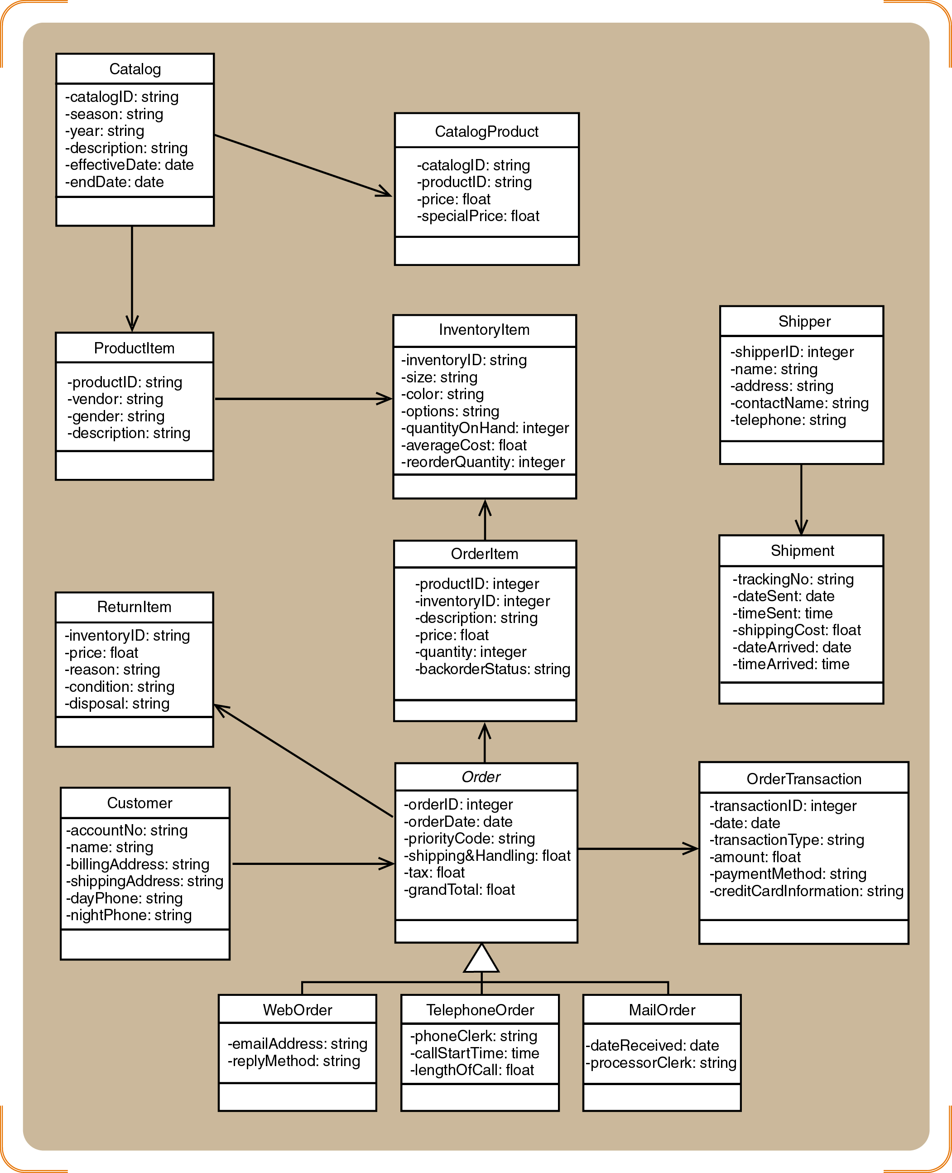
Design class diagram: First-cut
Add Navigation Visibility and attributes

Slide 17
Realizing Use Cases and Defining Methods
Realization of a use case determine which objects collaborate by sending messages to each other in order to achieve the functionality of a use case – Captured by a sequence Diagram (or communication diagram)
For Example Check item Availability usecase in an online ordering system

Slide 18
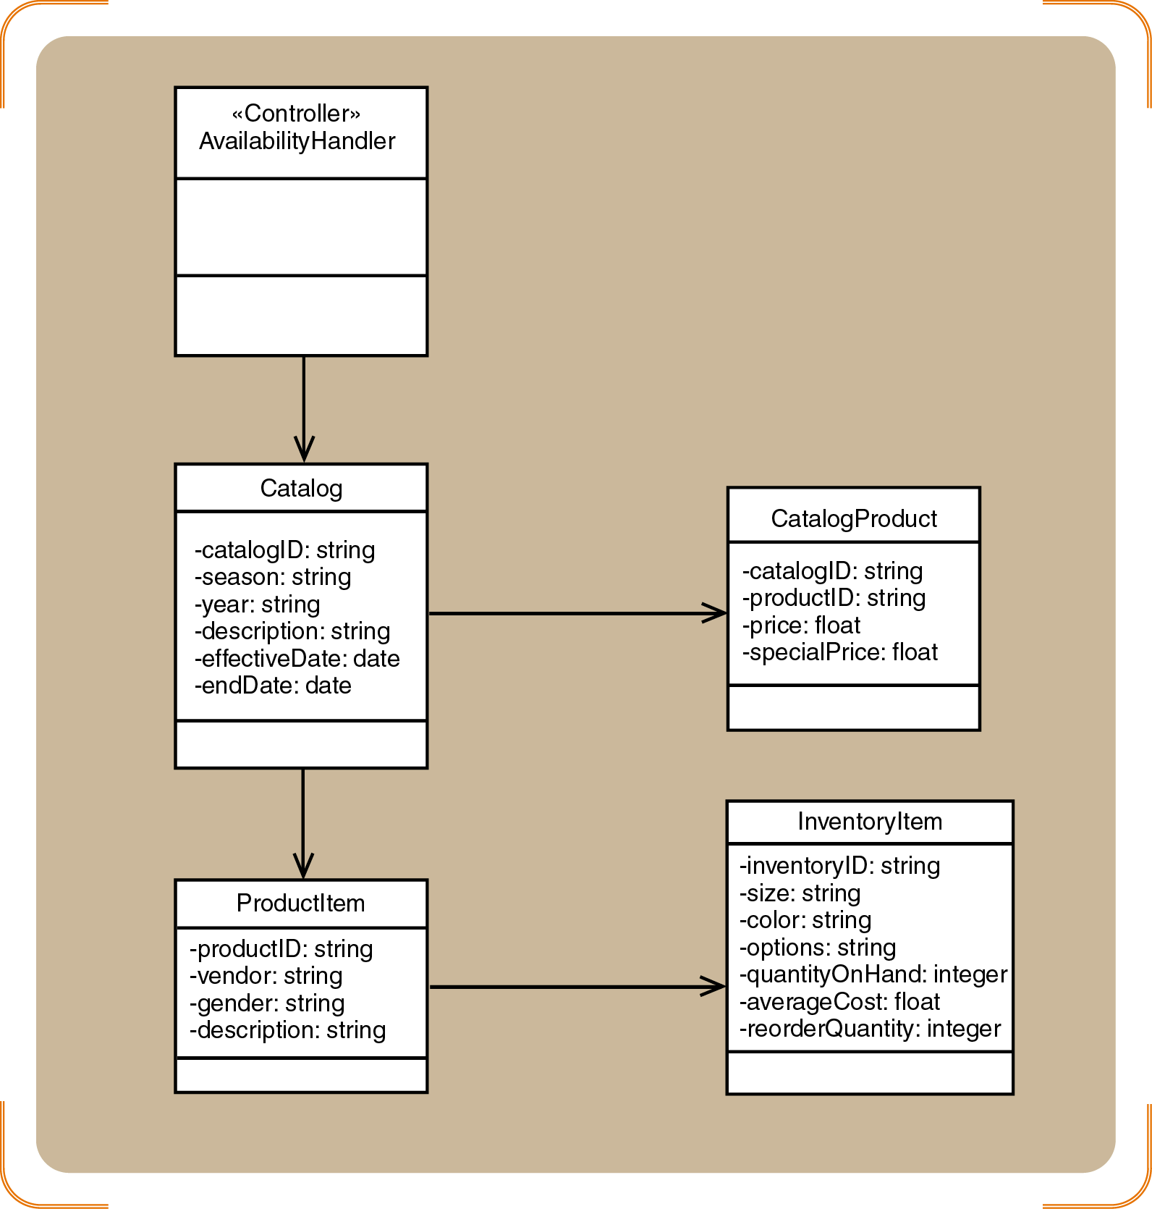
Partial design class diagram for Check item availability use case
Isolated the objects (classes) that collaborate to realize this use case

Slide 19
Use Case Controller
An artifact invented by the designer to handle a system function
Serves as a collection point for incoming messages
Intermediary between the outside world and the internal system
A single use case controller results in low cohesion
Several use case controllers raise coupling but result in high cohesion

Slide 20
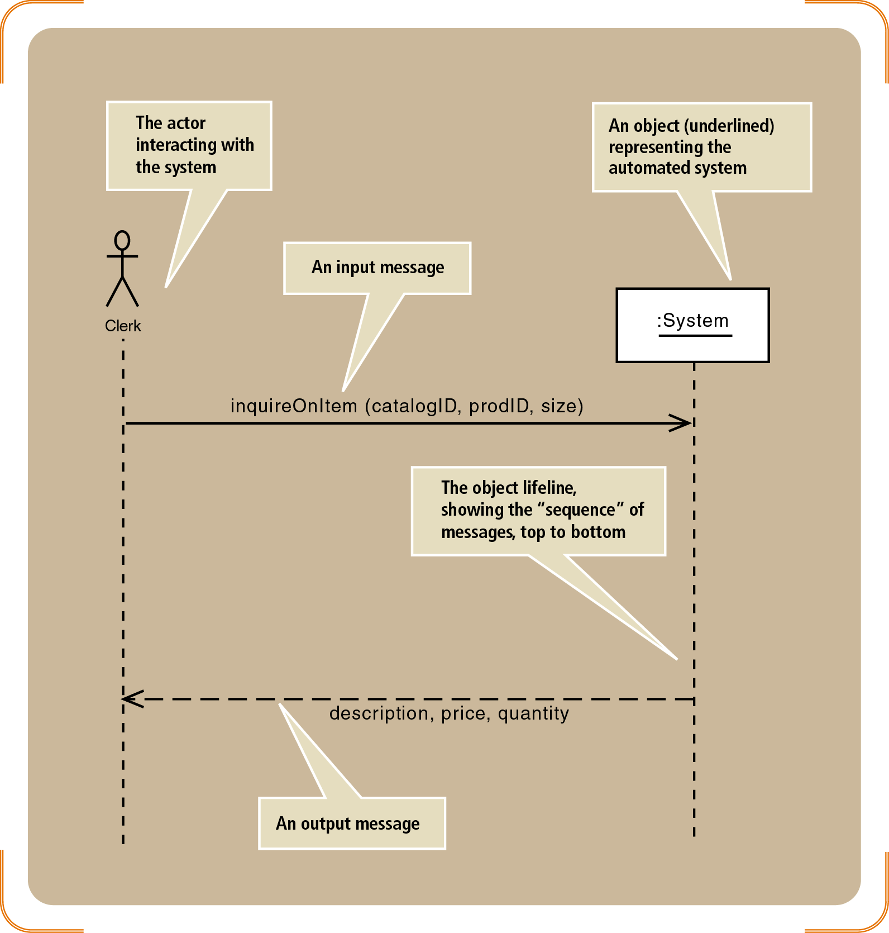
System Sequence and Sequence Diagrams
An SSD captures the interactions between the system and the external world represented by actors
The system is treated like a black box
A detailed sequence diagram uses all of the same elements as an SSD
The :System object is replaced by all of the internal objects and messages within the system
System Sequence Diagram for Check item availability

Slide 21
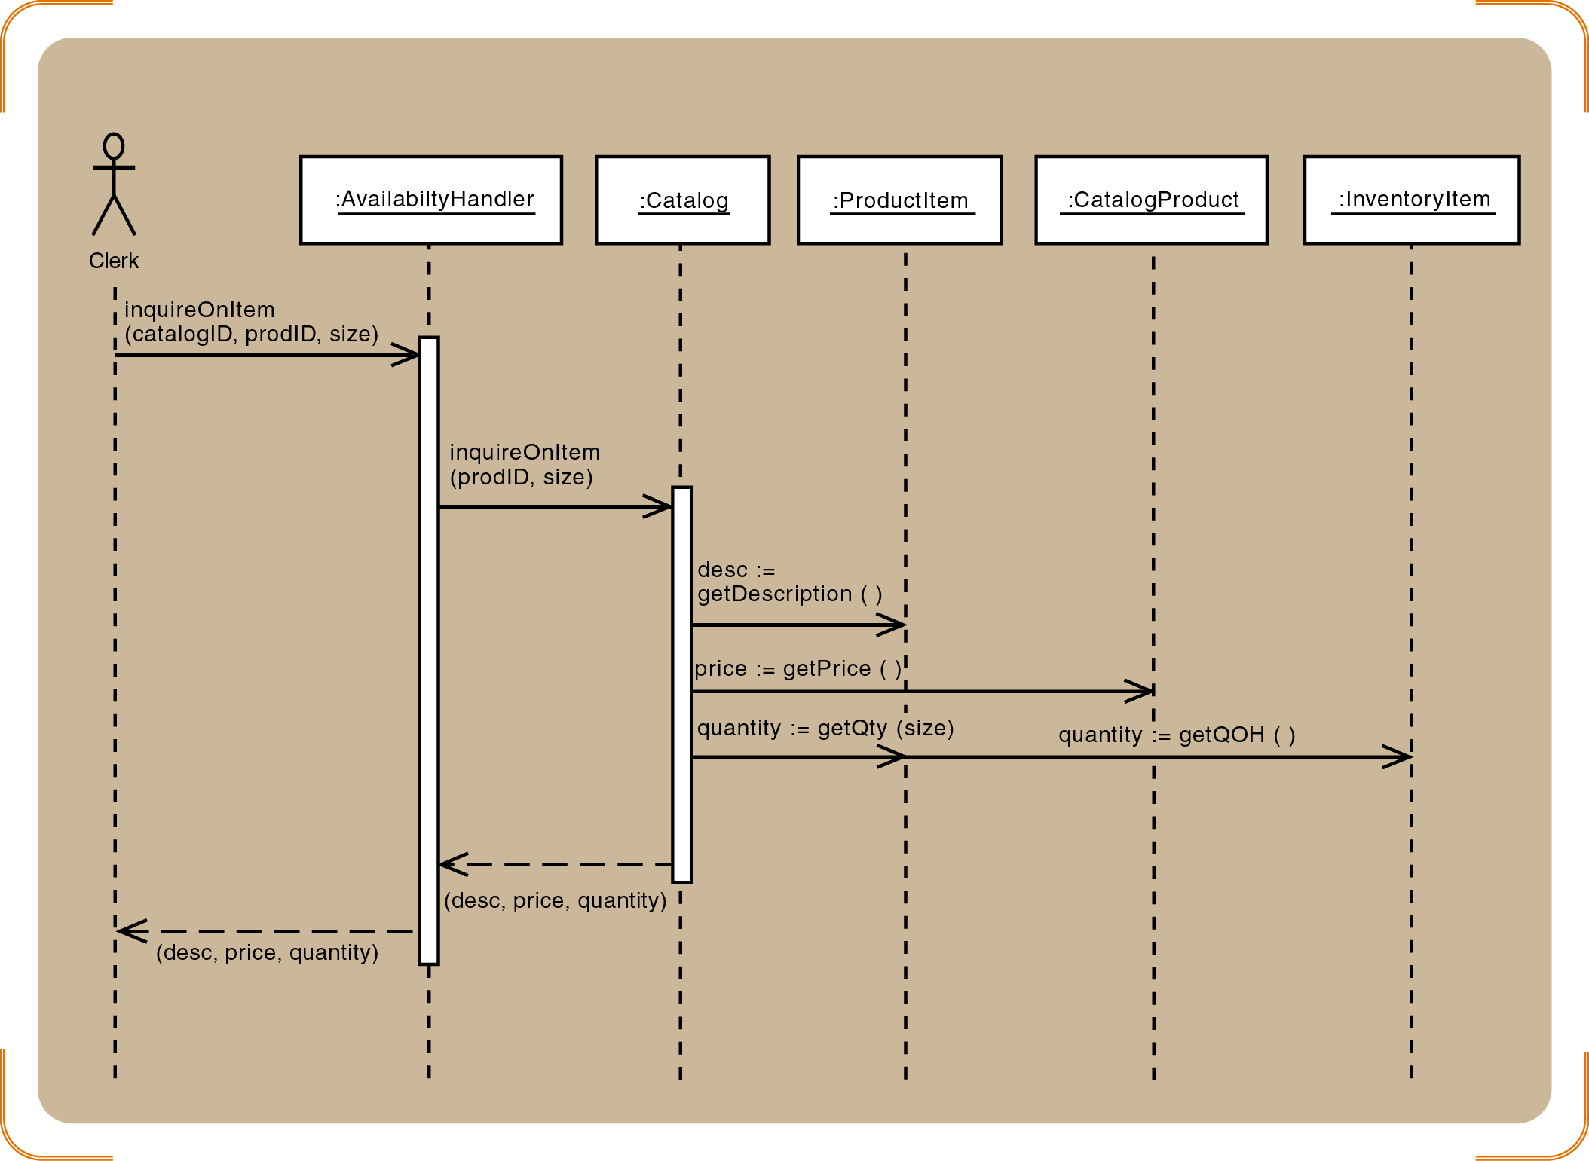
Usecase Realization: First cut sequence diagram

Slide 22
Layering : Three layered Design Problem Domain, Data Access, View(UI) based on MVC Architecture
View layer
Design the user interface for each use case
Develop dialog designs for forms
Add the window classes to the sequence diagram
Data Access layer
Initialize domain objects with data from the database
Query the database and send a reference object
Return information in the reference object

Slide 23
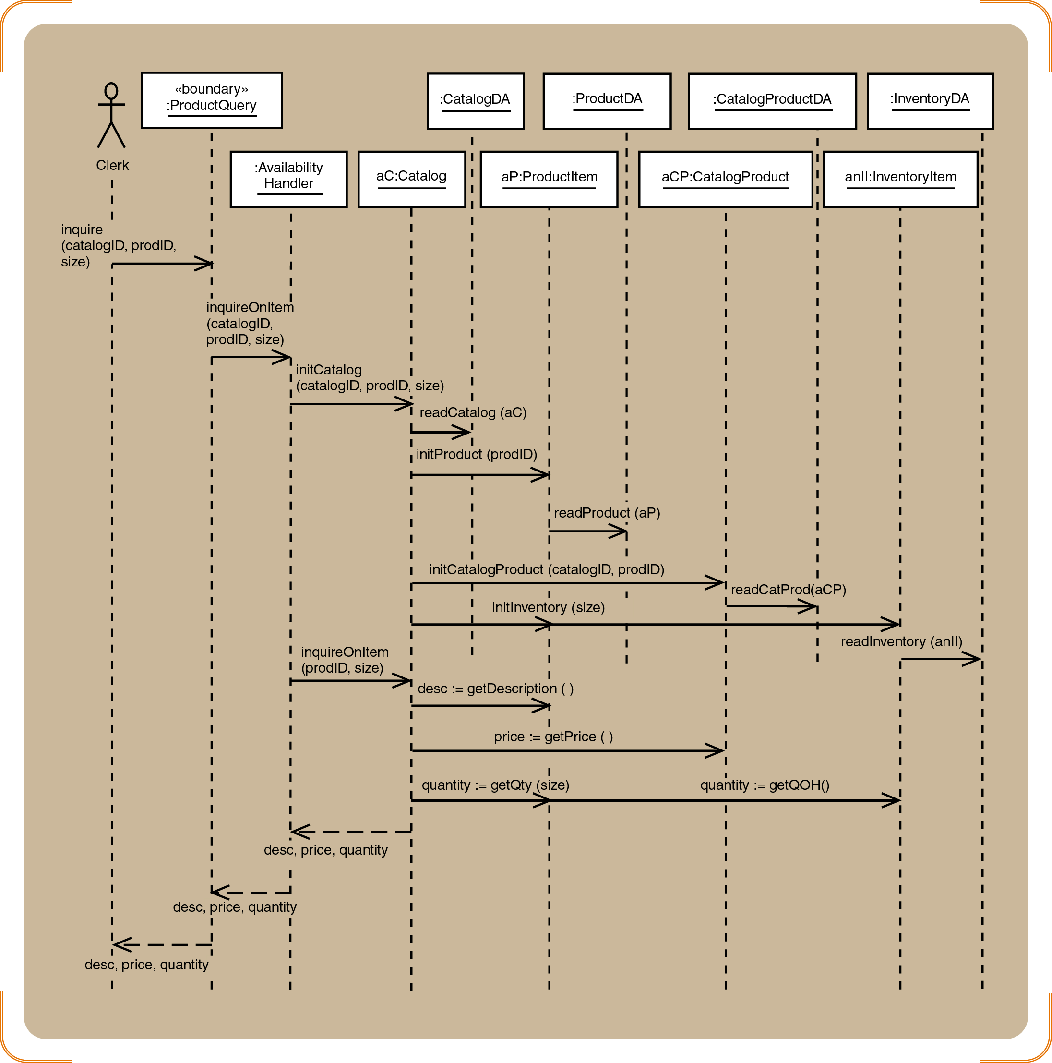
Three-layered Sequence Diagram for Check item availability
Object instantiation through the init messages-object persistence achieved by storing information in database

Slide 24
Design Class Stereotypes
Stereotypes
UML notation to categorize a model element as a certain type
Two types of notation
Full notation with guillemets («»)
Shorthand notation with circular icons
Standard stereotypes
Entity, control, boundary, data access

Slide 25
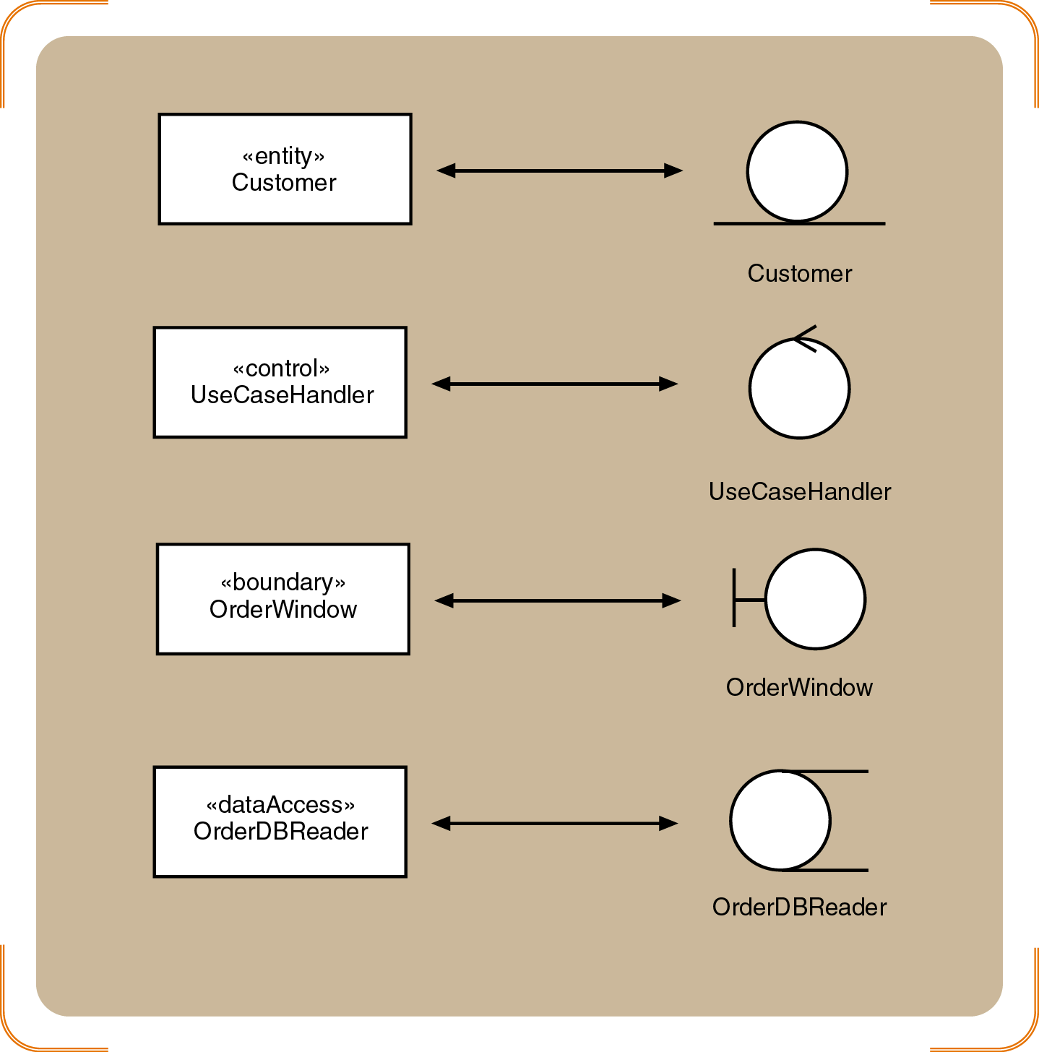
Figure 8-5
Standard stereotypes found in design models

Slide 26
Design Class Notation
Class name and stereotype information
Attribute information
Visibility, type-expression, name, initial value, and properties
Method signature
Visibility, name, type-expression, and parameter list
Use the entire signature to identify a method to distinguish between overloaded methods

Slide 27
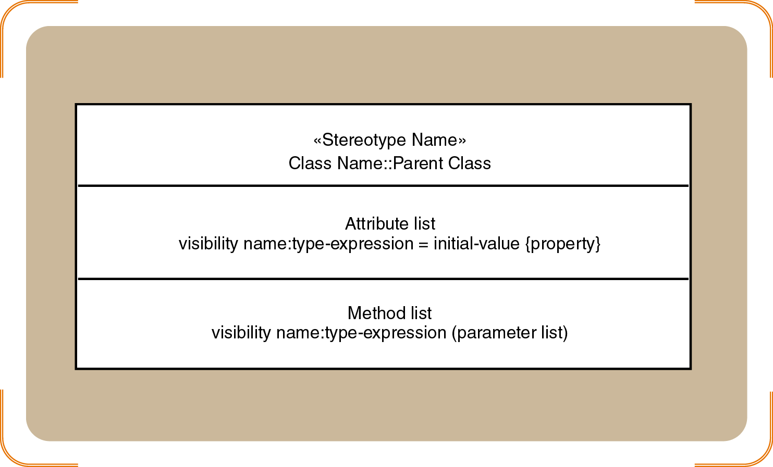
Design Class

Slide 28
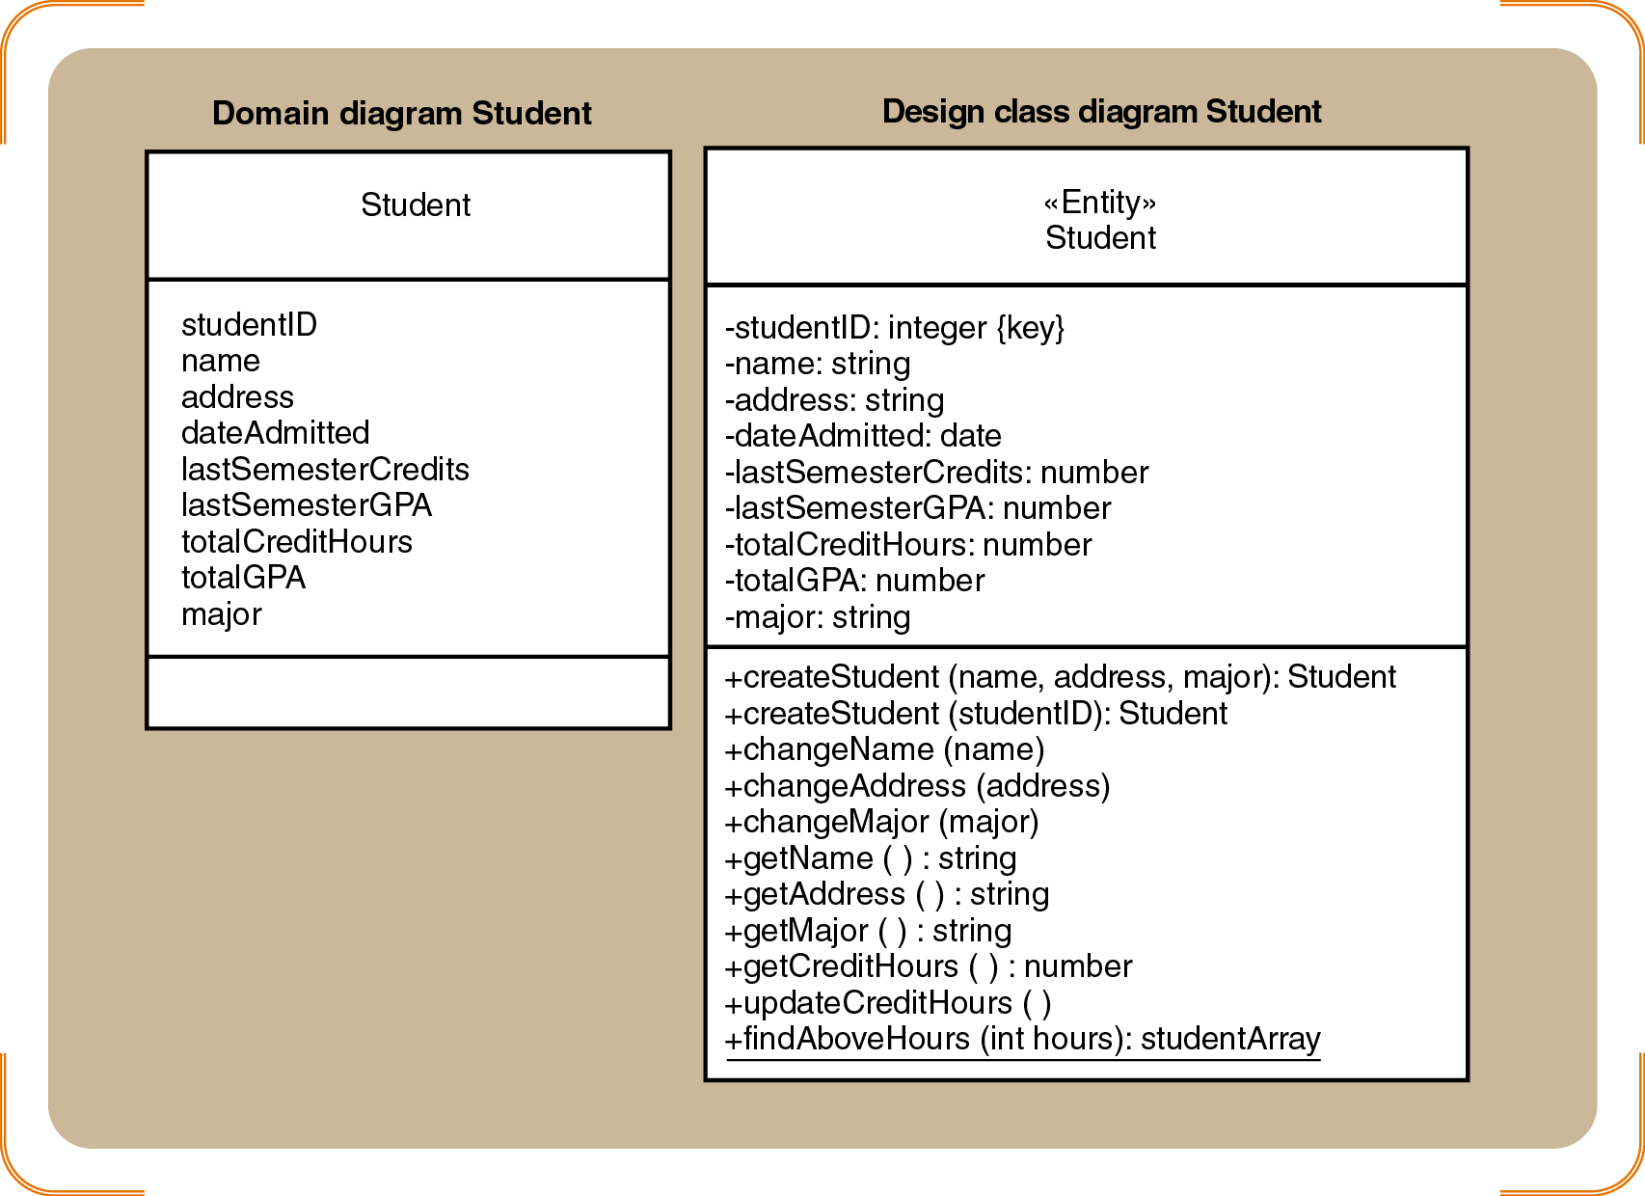
Student : Domain class diagram Vs Design class diagram

Slide 29
Create a Three Layered Use case Realization for
UC: Create new telephone order
This use case has multiple messages and a loop
which makes the use case realization a bit complicated

Slide 30
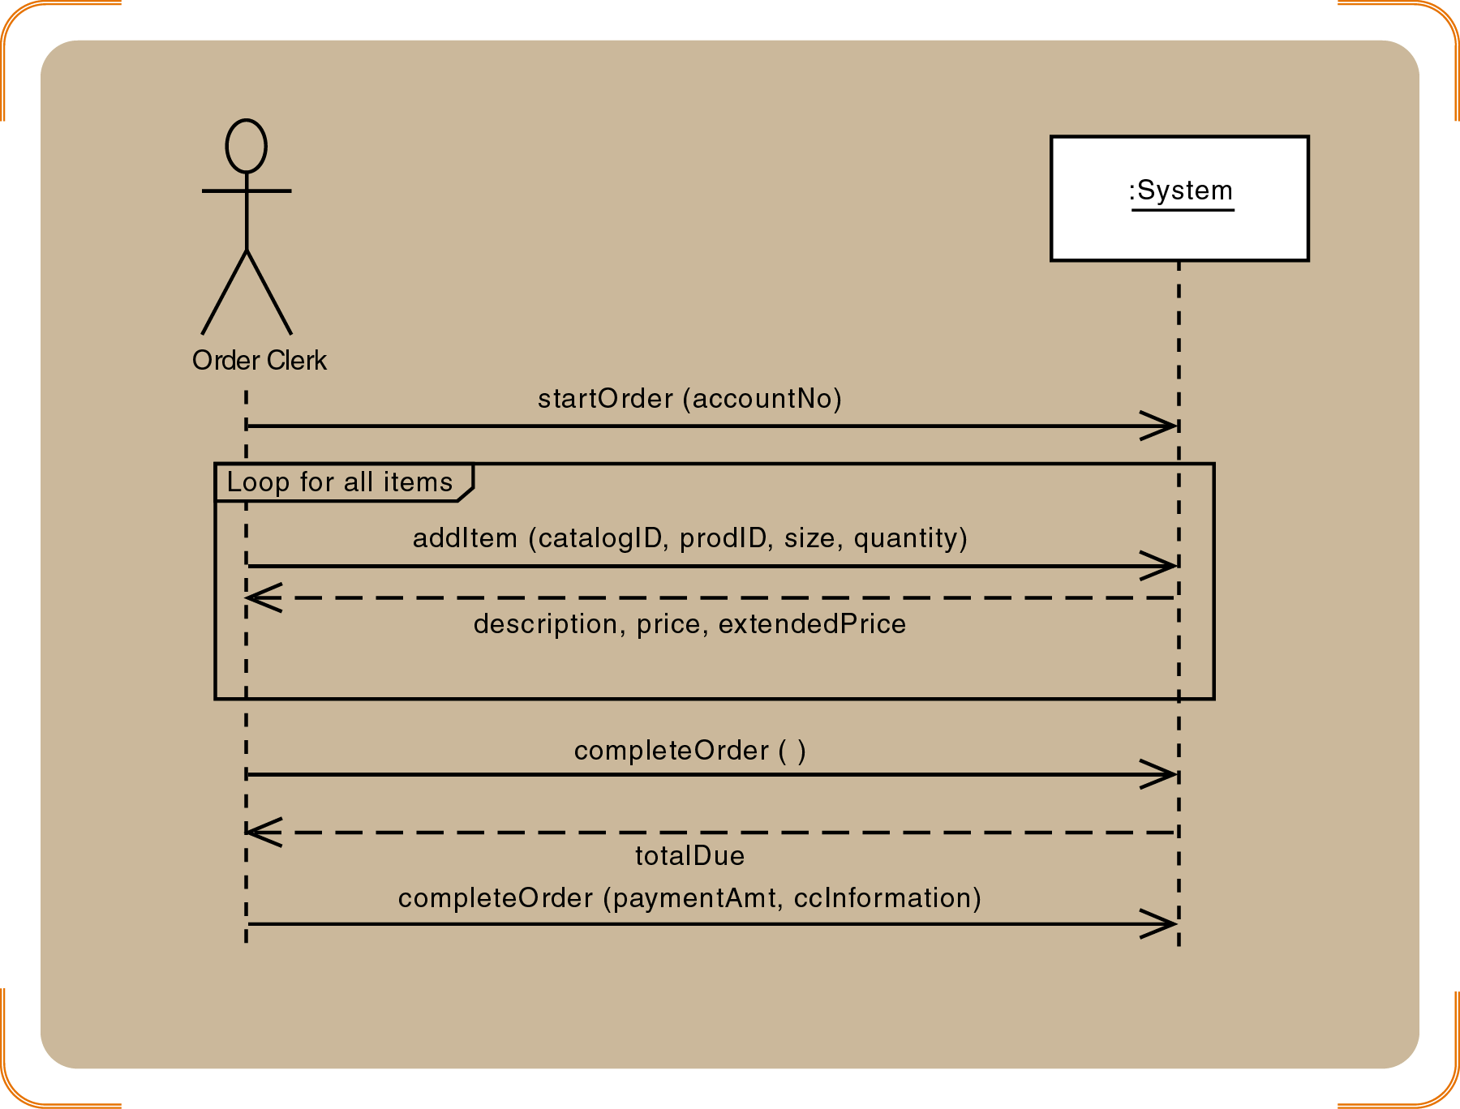
SSD for the Create new Telephone order use case

Slide 31
Carve out the
Objects with inherent Navigation flow from the first cut design class diagram

Slide 32
Define a usecase controller object
Define a “create” message for new Order objects
Customer object creates the Order object
Define other messages
addItem, createOrdItem, getDescription, getPrice, updateQty
Identify source, destination, and navigation visibility for each message

Slide 33
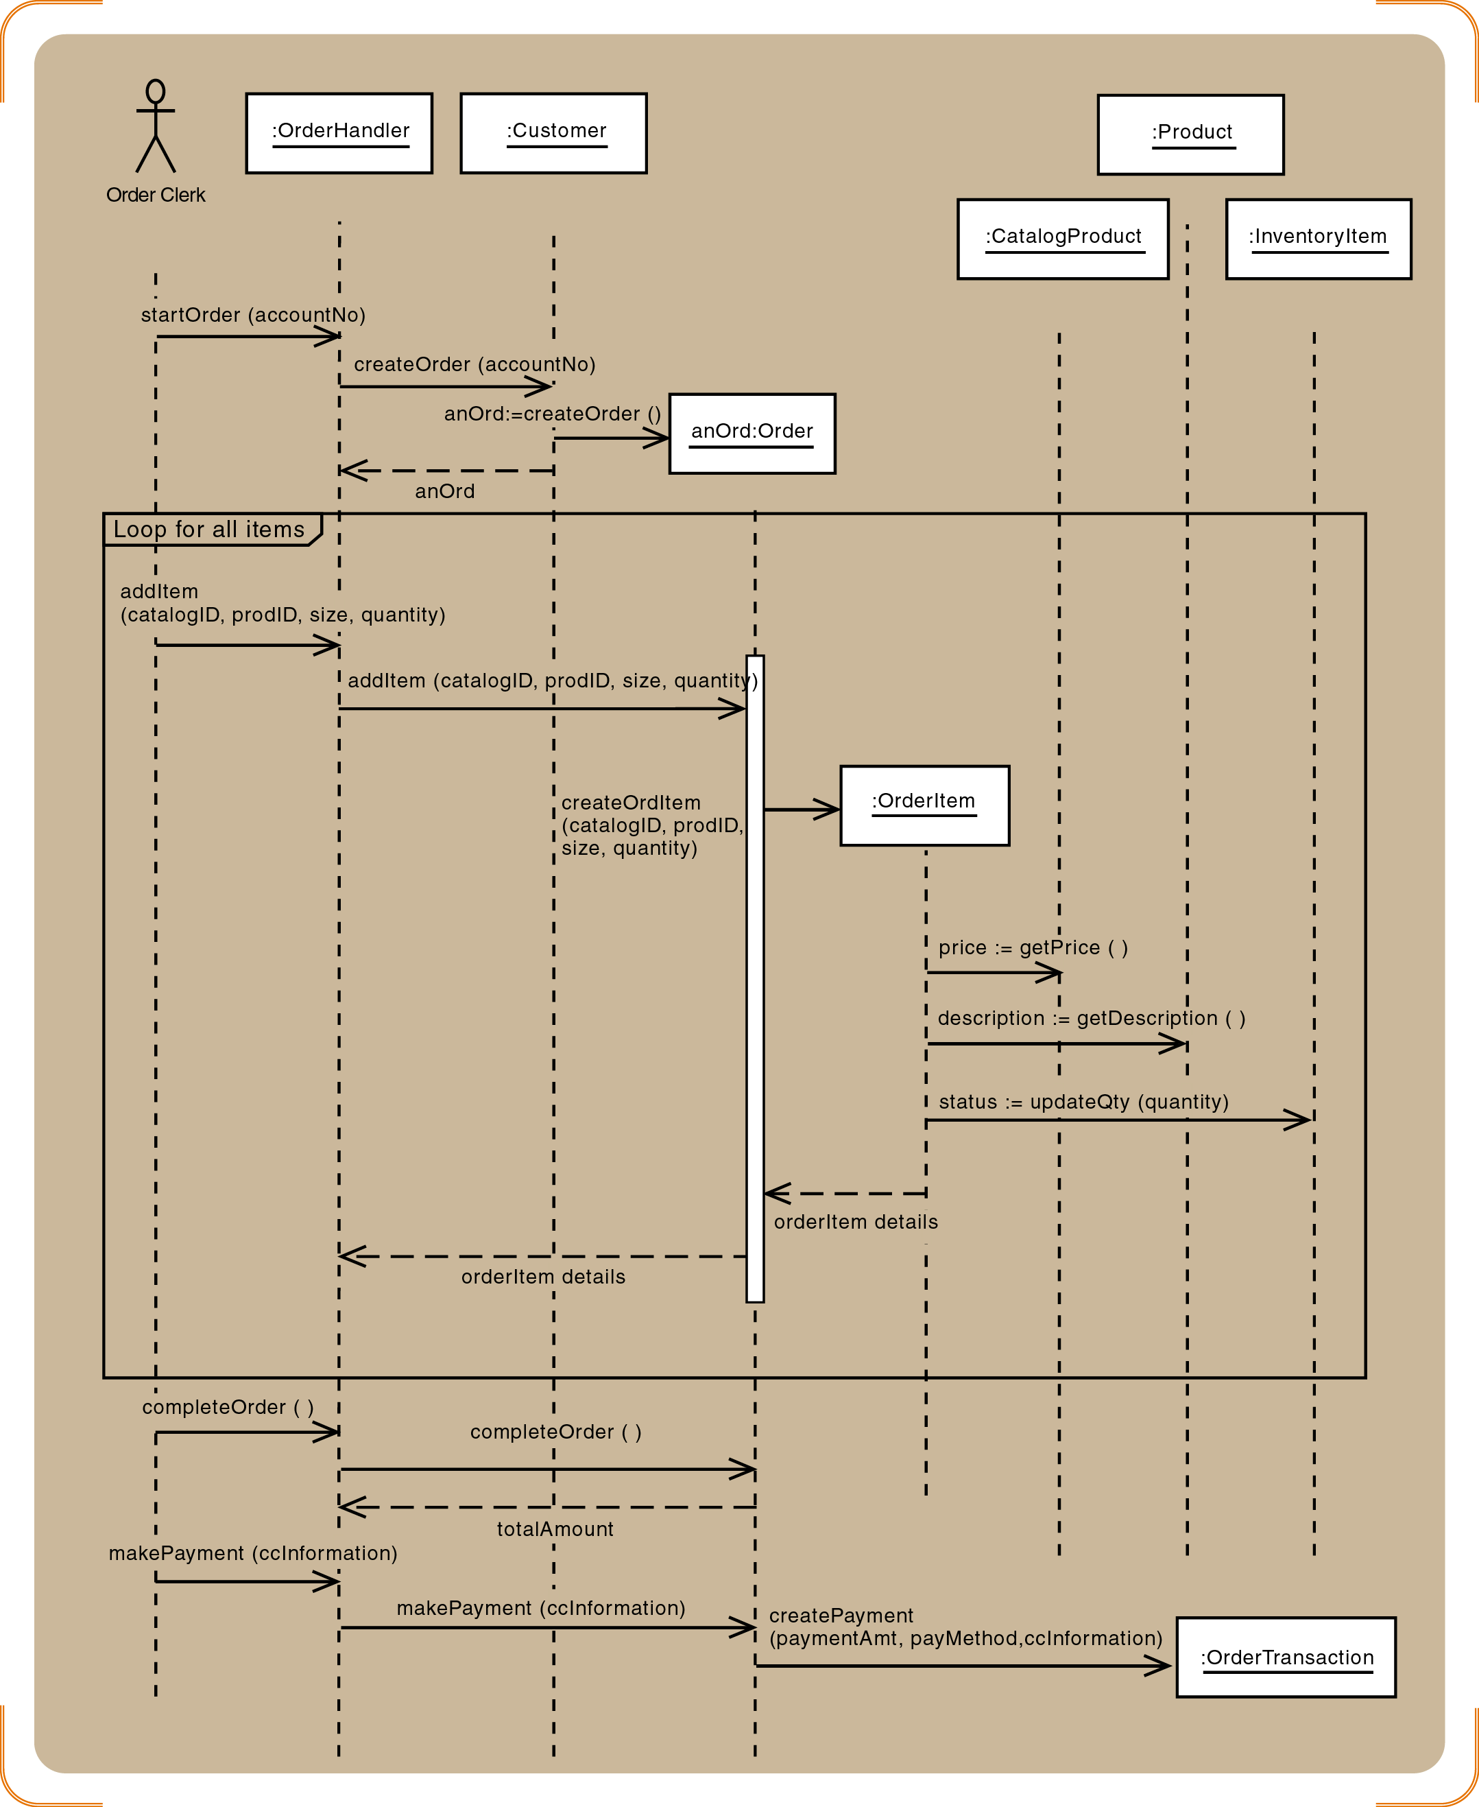
First Cut Use case realization without View and DA Layers

Slide 34
Use Cases with Multiple messages:
Adding View and DA Layers
Extend one message at a time
View layer:
Follow the partially developed dialog design/form-menu design in use case realization.
For example in this case Open Order window and return a Customer object to populate the new order form.
Data layer
Customer object is persistent so it will initialize itself by populating from the database.
Add items to an order with a repeating message
Save Order and OrderItem to the database
Update database inventory
Complete transaction

Slide 35
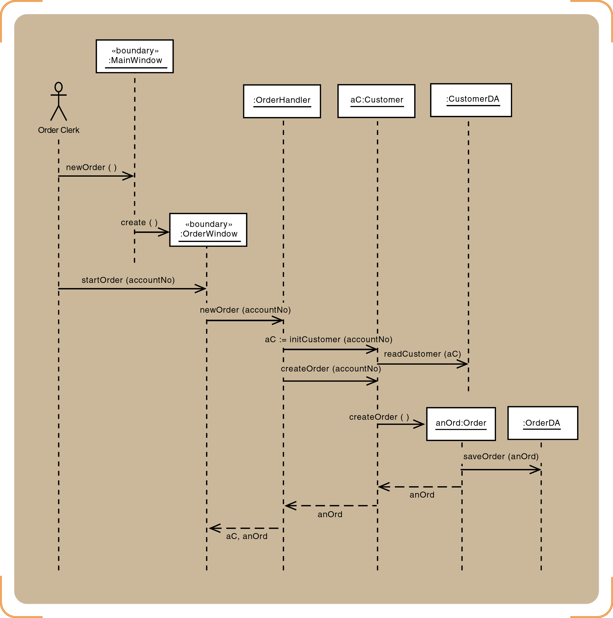
Three Layered UC Realization for the startOrder message

Slide 36
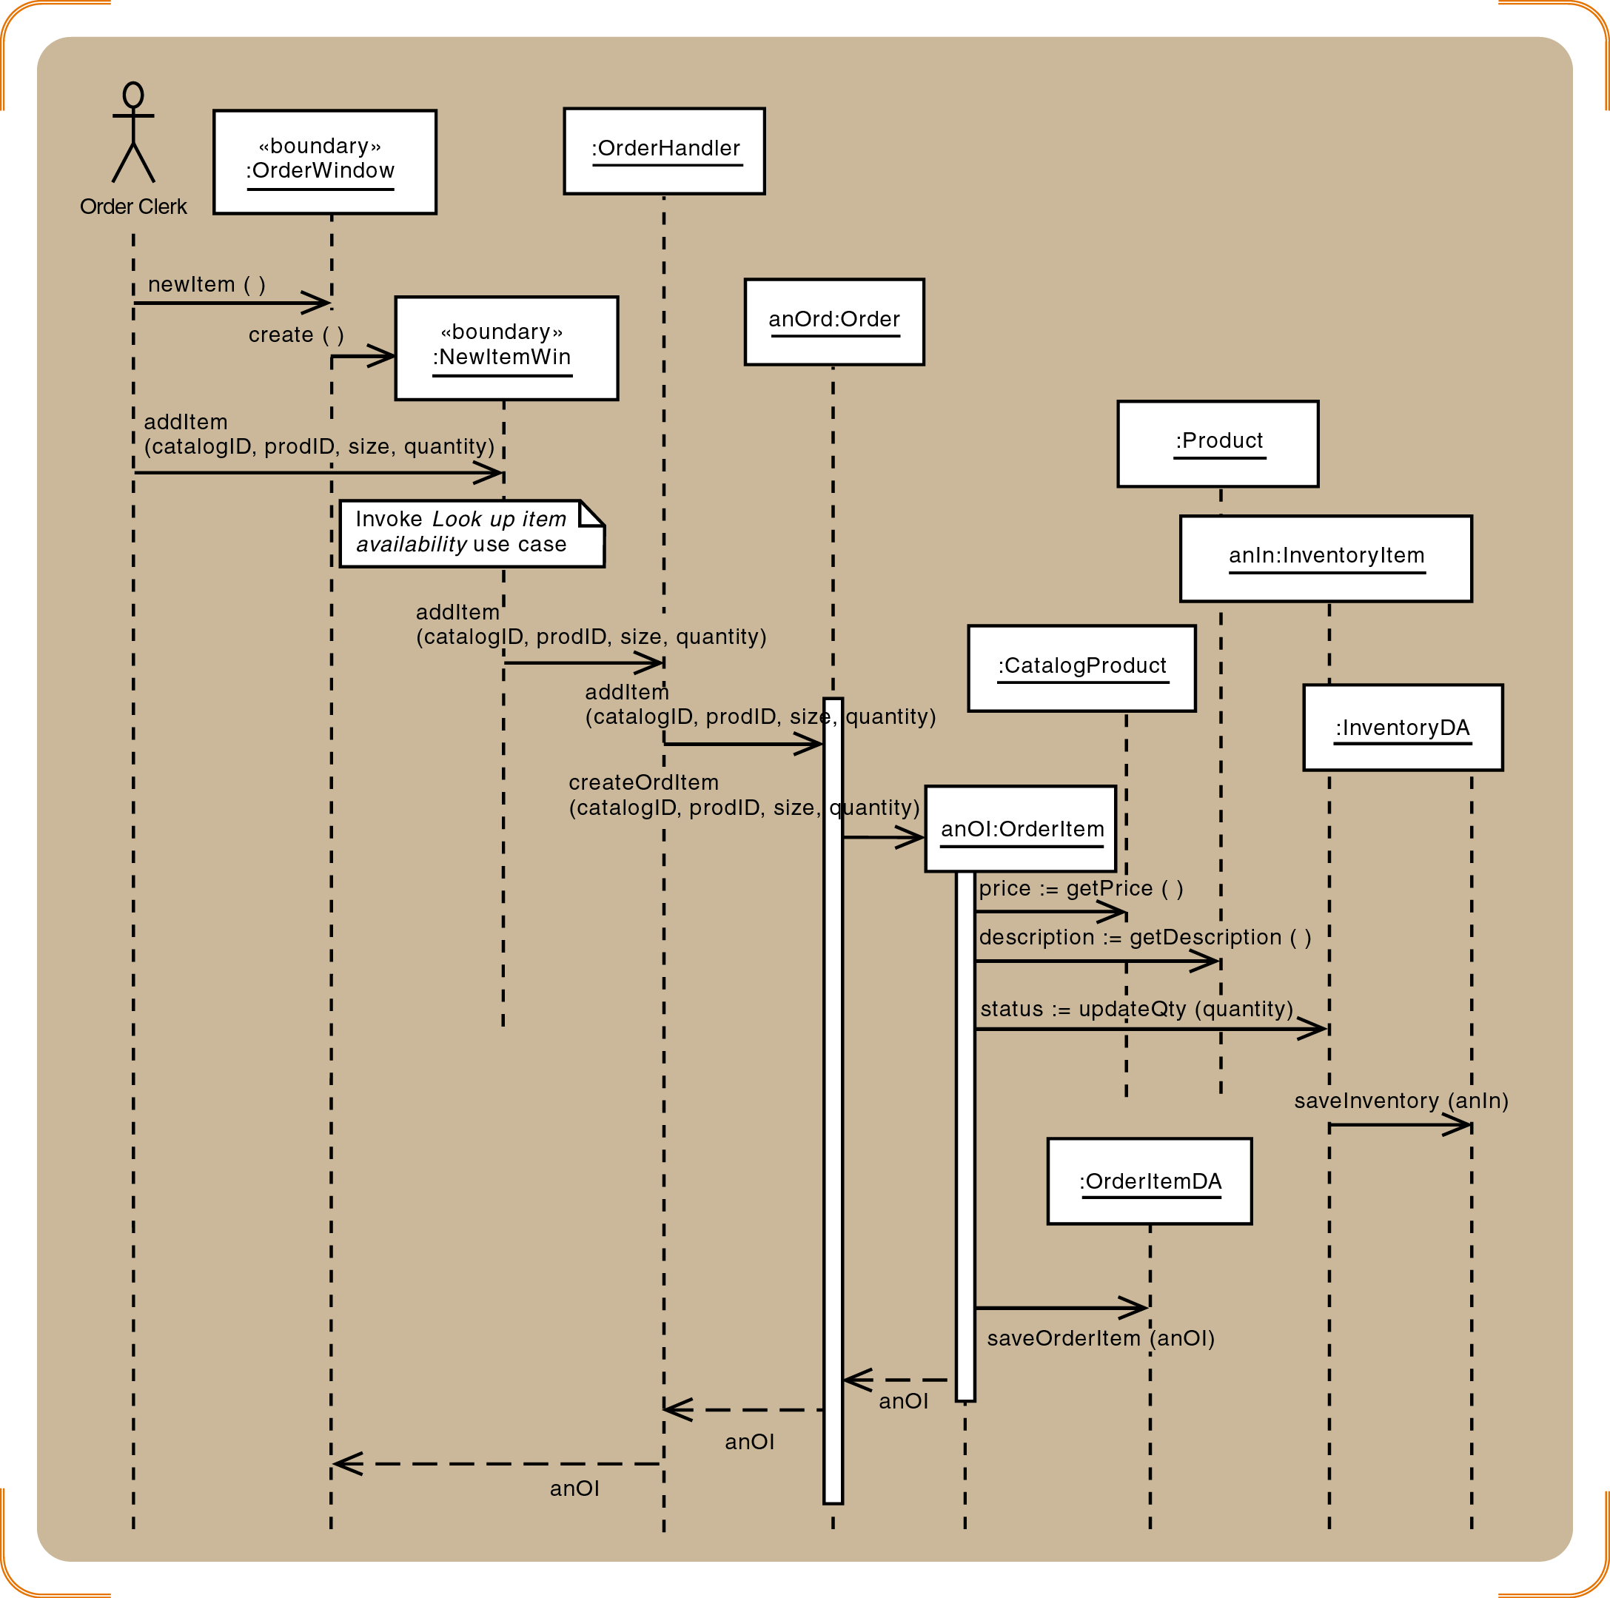
Three Layered UC Realization for the addItem message

Slide 37
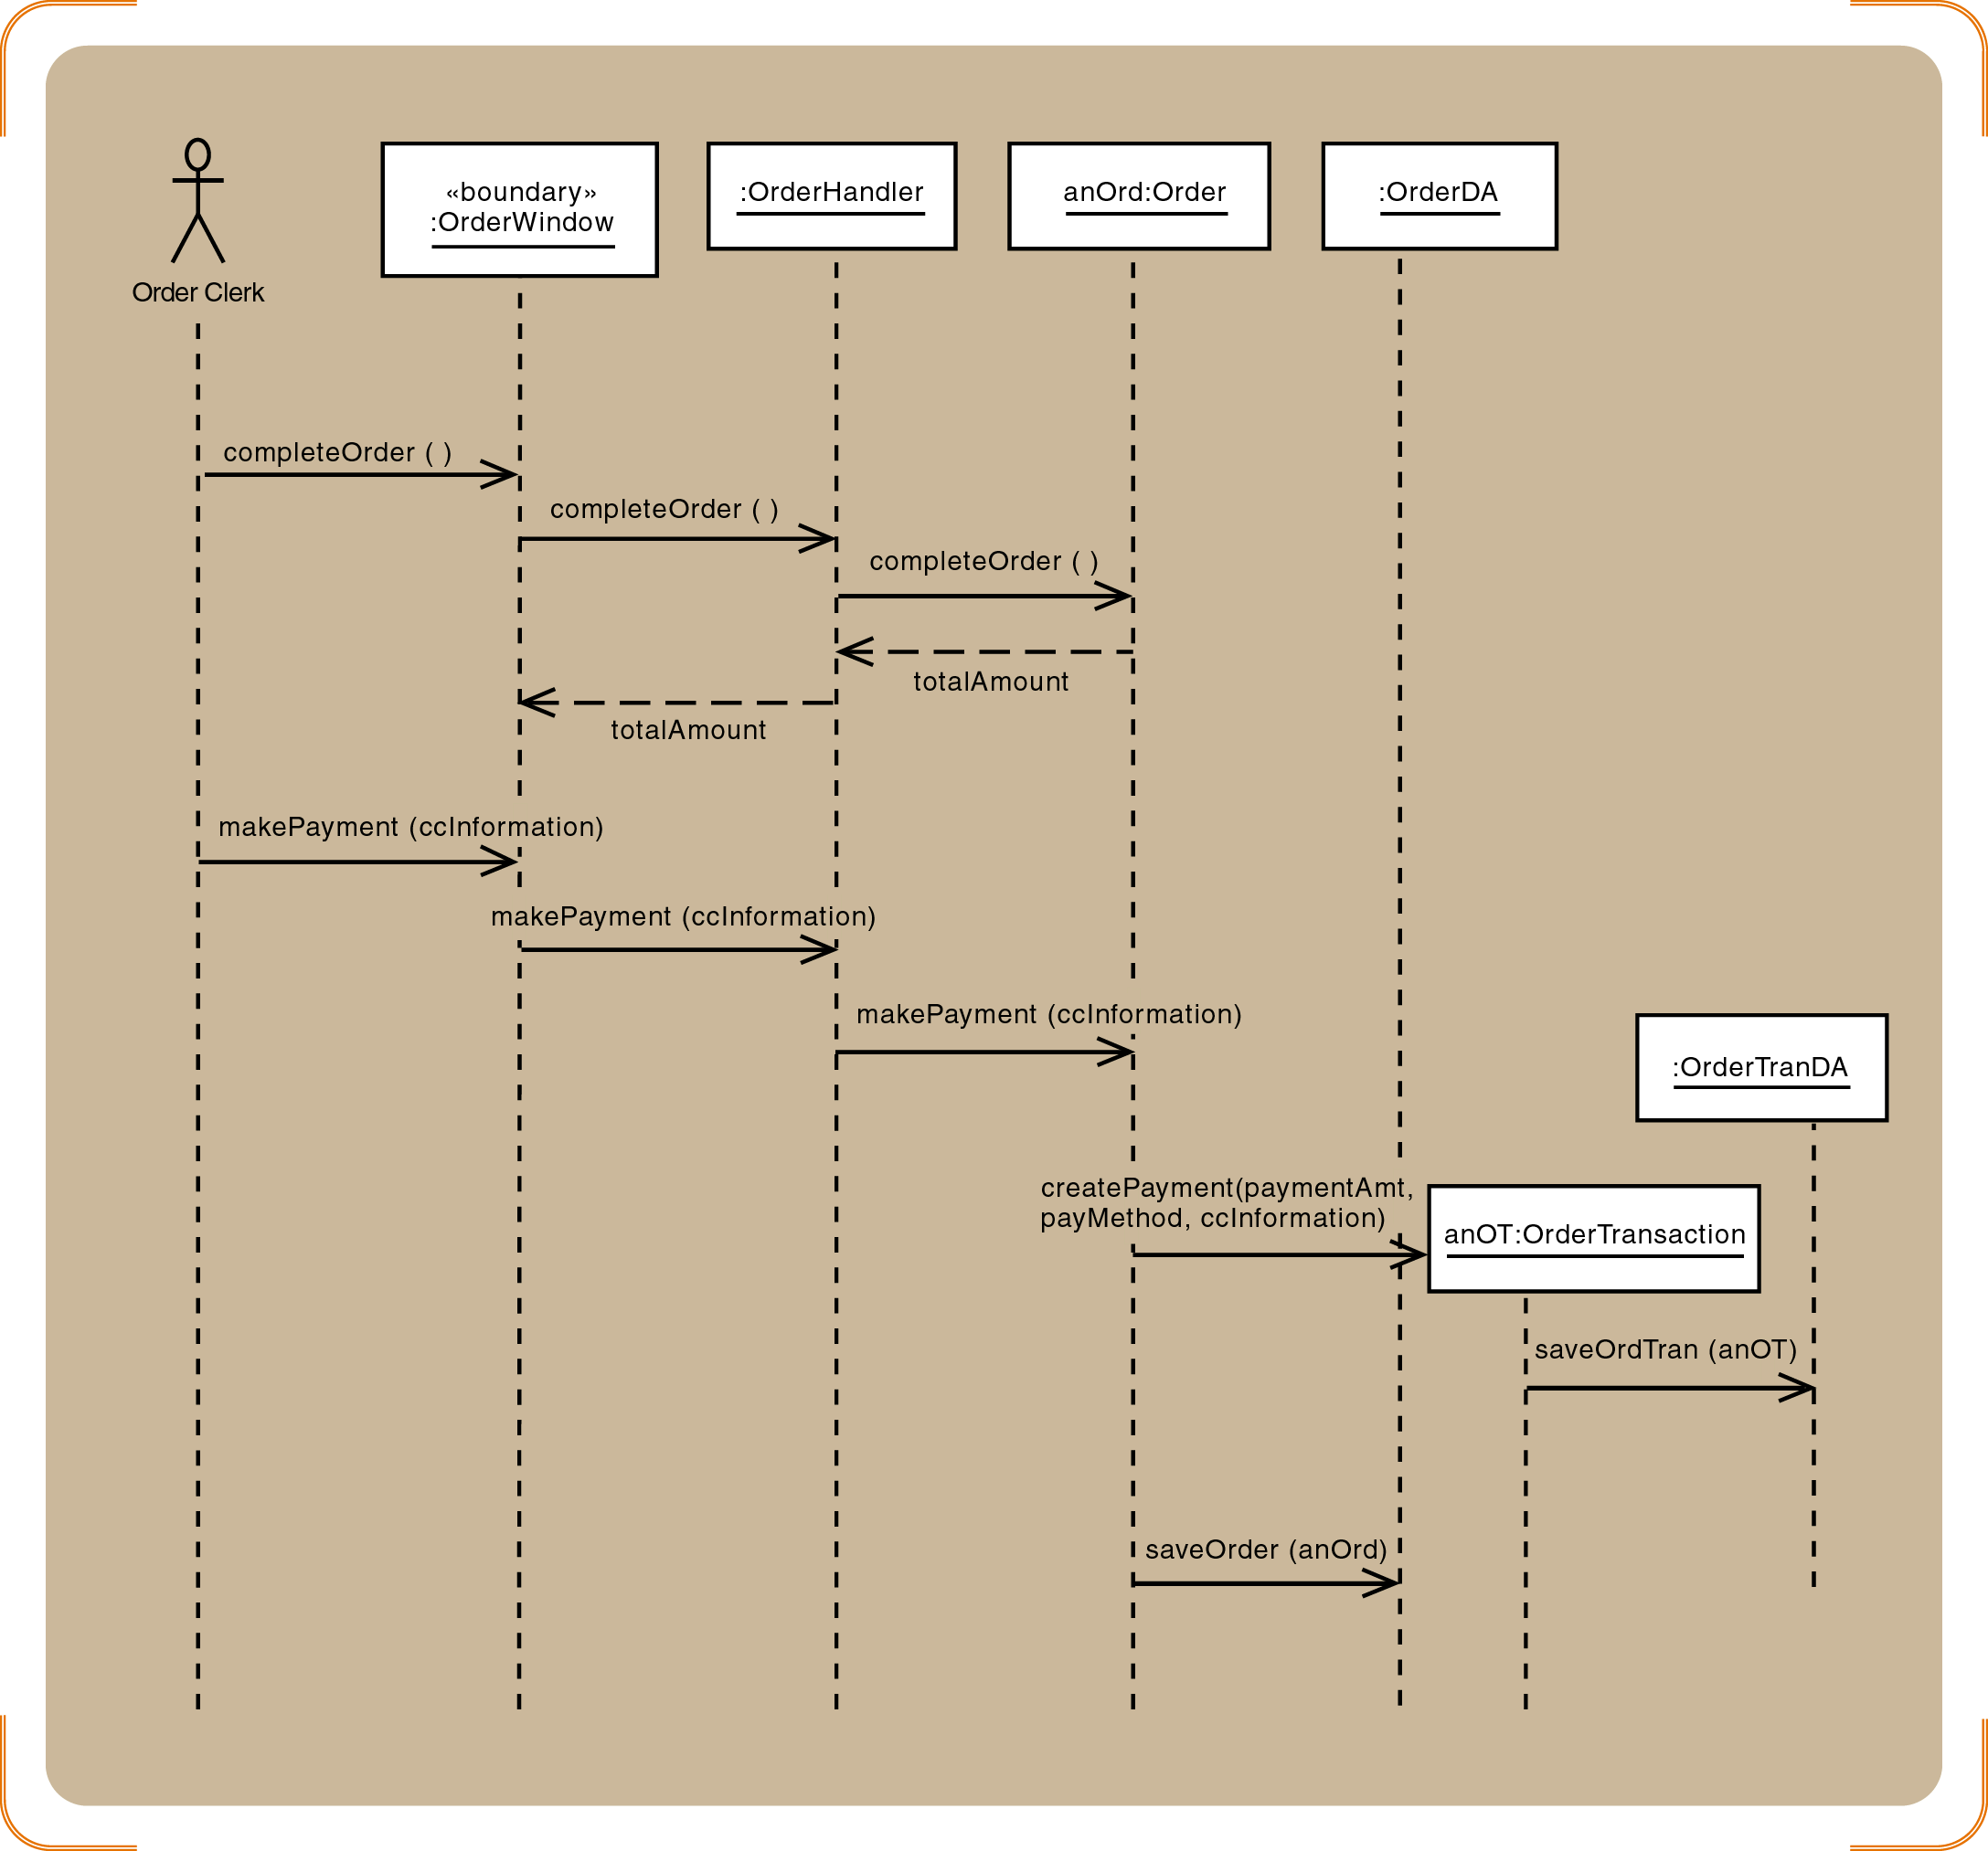
Three Layered UC Realization for the final message

Slide 38
Design Class Diagram: Finalization
Add classes for the view and data access layers
Update classes with method signatures
Constructor and get and set methods are optional
Use case specific methods are required
Every message in a sequence diagram requires a method in the destination object
Include the new user controller classes and add navigation arrows

Slide 39
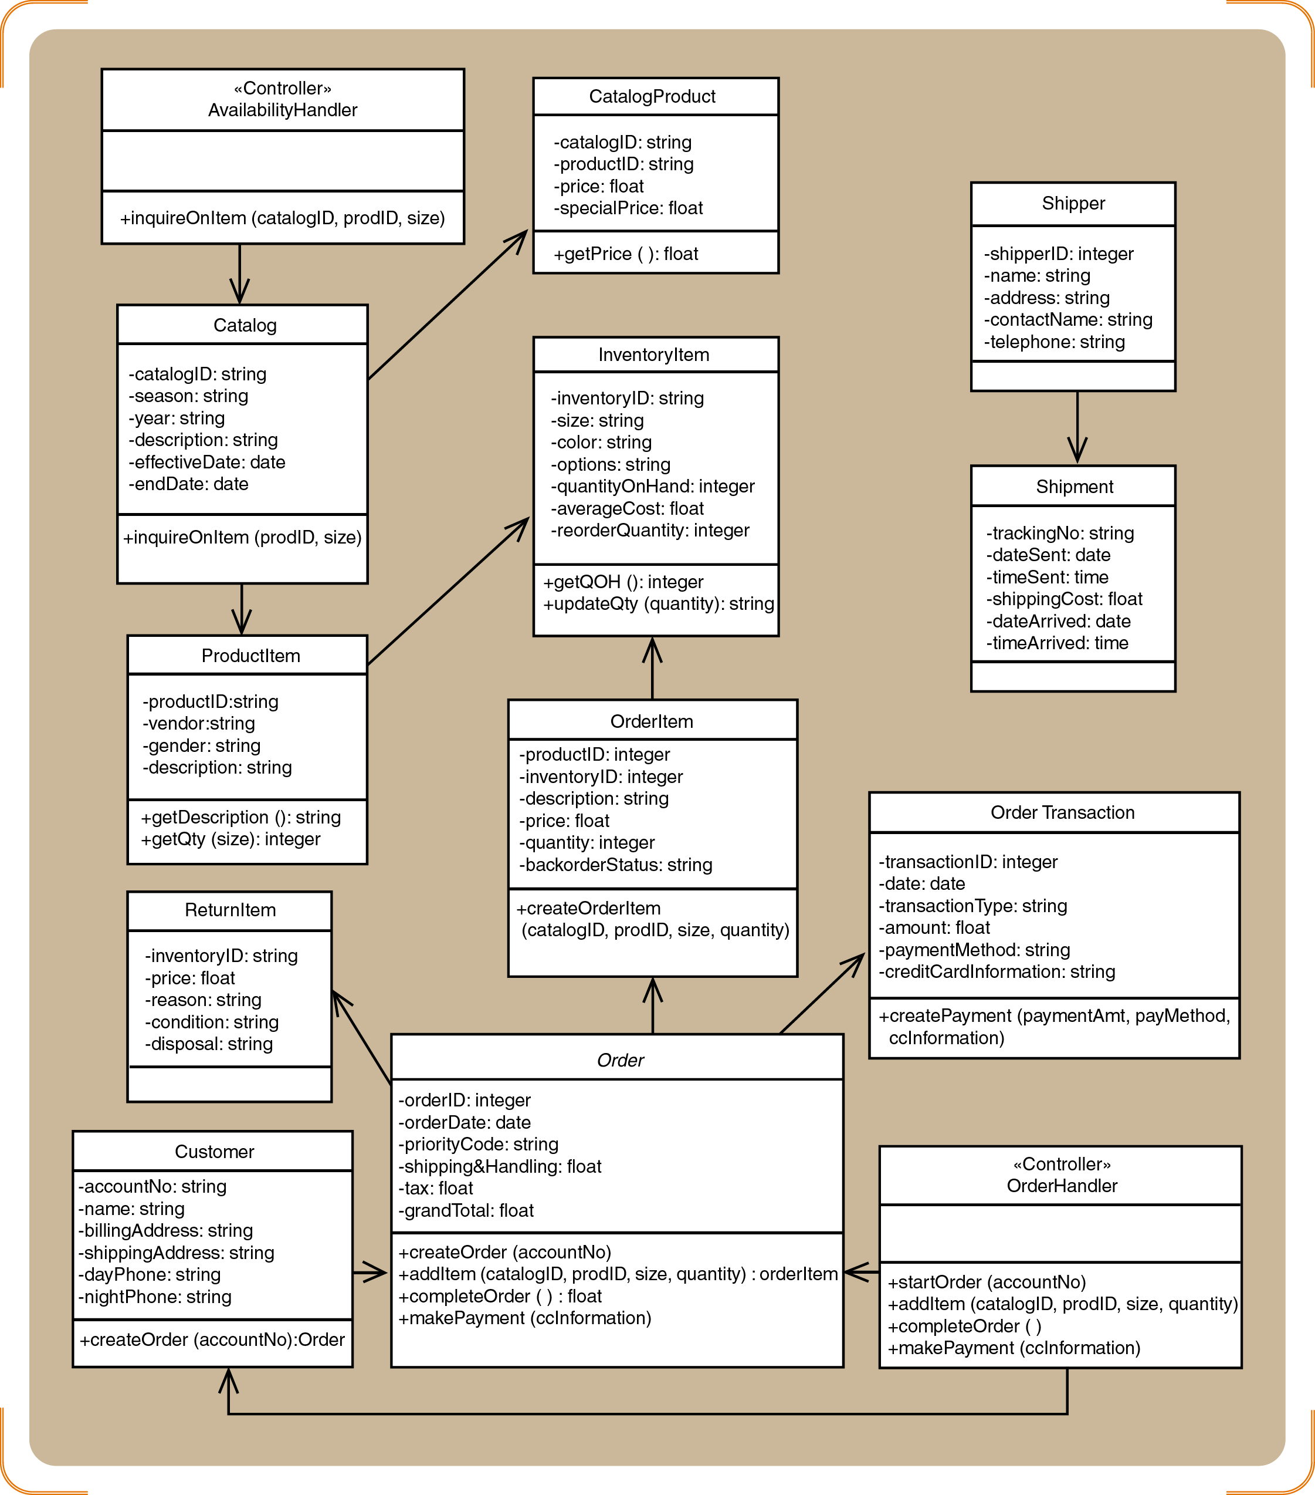
Updated design class diagram for the domain layer

Slide 40
Package Diagrams-Structuring the Major Components
Associates classes of related groups
One option is to separate the view, domain, and data access layers into separate packages
Indicate dependency relationships
Shows which elements affect other elements in a system
May exist between packages, or between classes within packages
Packages can be nested

Slide 41
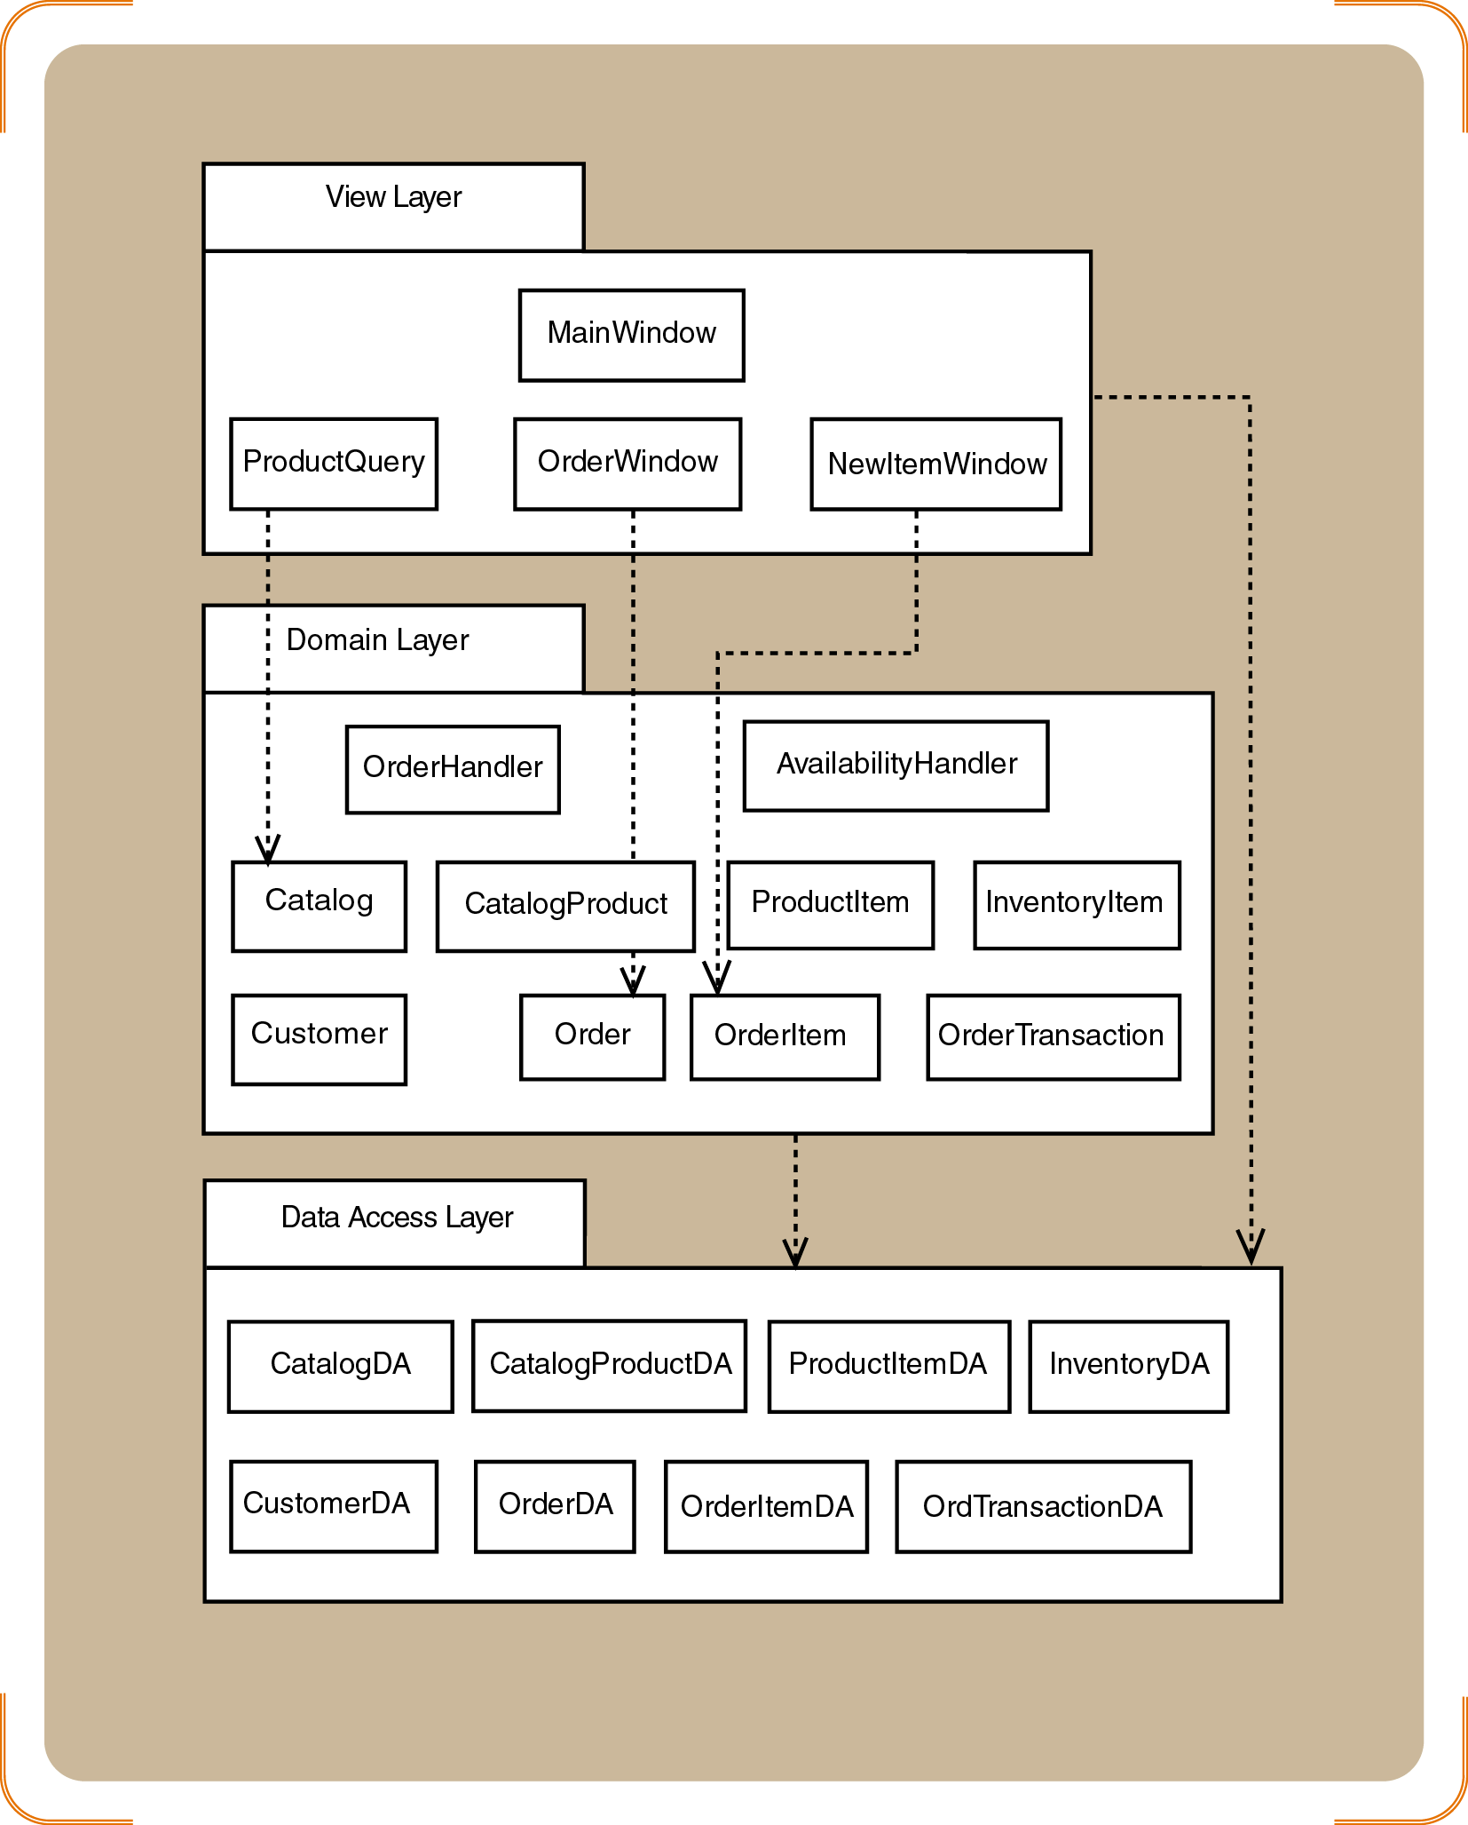
Three-layer package diagram

